Slide 1

Cybersecurity club

Slide 2

AGENDA
Cybersecurity news
What are hashes?
John the Ripper (password cracking)
Social media
Questions

Slide 3

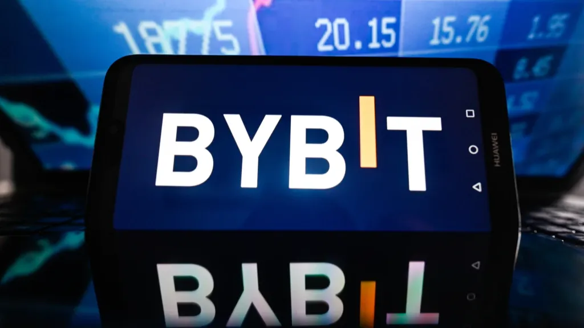
Cybersecurity news
Google Cloud has announced quantum-safe digital signatures in Google Cloud Key Management Service (Cloud KMS) for software-based keys as a way to bulletproof encryption systems against the threat posed by cryptographically-relevant quantum computers.
Cryptocurrency exchange Bybit revealed that a "sophisticated" attack led to the theft of over $1.5 billion worth of cryptocurrency from one of its Ethereum cold (offline) wallets, making it the largest ever single crypto heist in history.

Slide 4
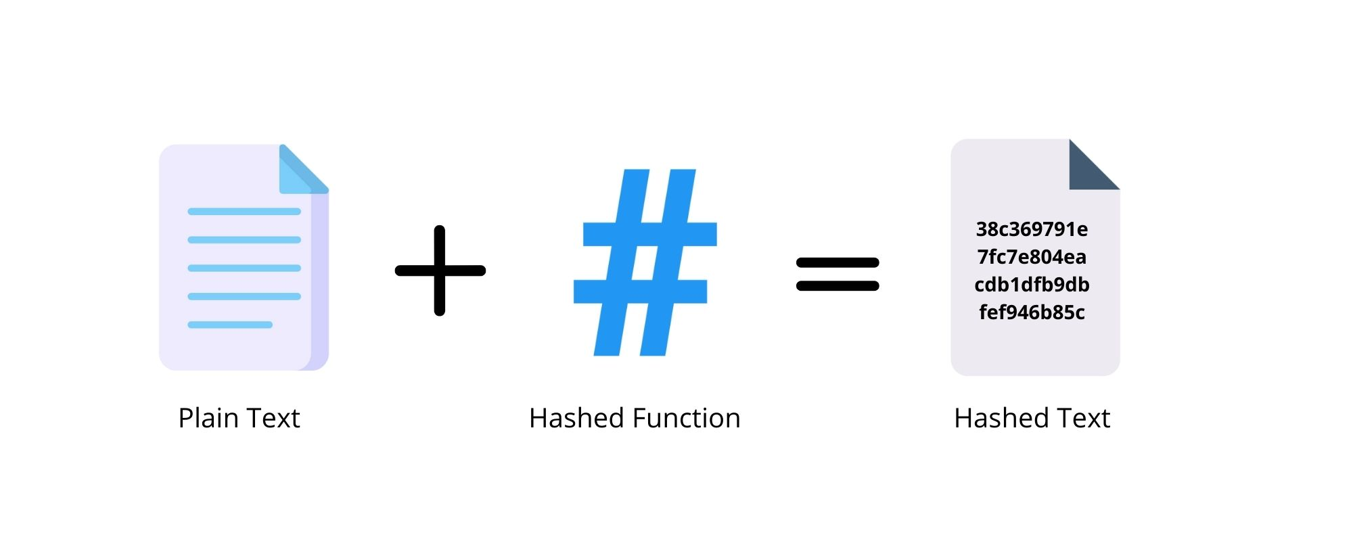

Hashes?
A hash is a way of taking a piece of data of any length and representing it in another fixed-length form
This process masks the original value of the data
This happens through hashing algorithms (MD5, SHA1, NTLM)
Take "Fort", a four-character string using MD5 it is "d611bfb203455185fe8254b27eaa73aa"
Now take "Fortnite", an 8-character string using MD5 it is "972b040498eb76771f064dd2c761edc9"

Slide 5
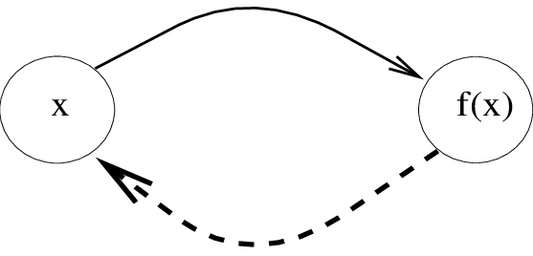
Why are they secure?
Hashes are one-way functions meaning if you have the input, it is easy to solve but without it is hard
They do this utilizing the modulo operator which is basically the remainder of a problem
16 mod 5 = 1
The modulo is not revisable, in the example you get 1 and that's great but there are infinite combinations to get that same number
So, to solve it you have to use brute force
This is where John the Ripper comes in as a way to do a dictionary attack

Slide 6
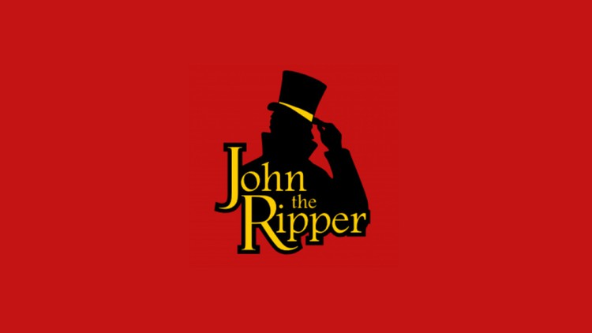
John the ripper installation/preparation
Windows
Go to the GitHub and download the zip file
Linux
Debian: sudo apt install john
RedHat: sudo dnf install john
For the wordlist download it from GitHub
More info: https://www.openwall.com/john/
Tasks: https://github.com/bsucyber/CyberClub_John

Slide 7
John the ripper basics
Syntax
john [options] [file path]
john: invokes the John the Ripper program
options: what options you choose to use
file path: the file you want to crack
john --wordlist=[path to wordlist] [path to file]
path to wordlist: wordlist mode
path to file: the hash file
john --wordlist=rockyou.txt hash_to_crack.txt
Identifying hashes
Website: hashes.com
Python script
wget https://gitlab.com/kalilinux/packages/hash-identifier/-/raw/kali/master/hash-id.py
GitHub download
To run it use: python3 hash-id.py
Type the hash into the prompt and it will give you possible hashes that it could be

Slide 8
John the ripper basics
john --format=[format] --wordlist=[path to wordlist] [path to file]
format: what type of hash it is (MD5, SHA1, NTLM, etc.)
john --format=raw-md5 --wordlist=rockyou.txt hash_to_crack.txt
Formatting notes
In the example above it uses raw- to state it is a standard type
To check use: john --list=formats | grep -iF "md5"
We will be using Games.txt for our wordlist and in the task1 folder we will using the Hash.txt
Find out what type of hash each one is in task1
Crack the hash
Check answers with me

Slide 9
Cracking windows authentication hashes
NTHash/NTLM
NThash is the hash format modern Windows operating system machines use to store user and service passwords
NT stands for new technology
In Windows, SAM (Security Account Manager) is used to store user account information, including usernames and hashed passwords
You can get the hashes by dumping that data using a tool like Mimikatz or using the Active Directory database: NTDS.dit
Find out what type of hash it is in task2
Crack the hash
Check answers with me

Slide 10
Single crack mode
In this mode, John uses only the information provided in the username to try and work out possible passwords heuristically by slightly changing the letters and numbers contained within the username
Say the username was "Isaac"
Some possible passwords could be: Isaac1, Isaac2, ISaac, ISAac, Isaac!, Isaac$
This is called word mangling
John uses a set of rules for mangling
It is used to exploit poor passwords that relate to the username
john --single --format=[format] [path to file]
--single: single hash-cracking mode
john --single --format=raw-sha256 hashes.txt
The format changes in the text hash file
"632feedc305ae29e4e44b560e83d847a"
"Isaac:632feedc305ae29e4e44b560e83d847a"
Find out what type of hash it is in task3
Crack the hash
Check answers with me

Slide 11
Cracking passwords protected zip files
zip2john [options] [zip file] > [output file]
[options]: Allows you to pass specific checksum options to zip2john (not often used)
[zip file]: The path to the Zip file you wish to get the hash of
>: This redirects the output from this command to another file
[output file]: This is the file that will store the output
zip2john zipfile.zip > zip_hash.txt
Take the output from zip2john and put it into john
john --wordlist=rockyou.txt zip_hash.txt
Make a hash file from the zip in task4
Crack the hash
Unzip the file
Check answers with me

Slide 12
Cracking Password-Protected RAR Archives
rar2john [rar file] > [output file]
[rar file]: The path to the RAR file you wish to get the hash of
>: This redirects the output of this command to another file
[output file]: This is the file that will store the output from the command
rar2john rarfile.rar > rar_hash.txt
Take the output from rar2john and put it into john
john --wordlist=rockyou.txt rar_hash.txt
Make a hash file from the rar in task5
Crack the hash
Unrar the file
Check answers with me

Slide 13
Cracking SSH Keys with John
ssh2john converts the id_rsa private key, which is used to log in to the SSH session
ssh2john [id_rsa private key file] > [output file]
[id_rsa private key file]: The path to the id_rsa file you wish to get the hash of
>: This is the output director
[output file]: This is the file that will store the output from
john --wordlist=rockyou.txt id_rsa_hash.txt
Make a hash file from id_rsa in task6
Crack the hash
Check answers with me

Slide 14



Social Media
Instagram
Discord
https://dsc.gg/bsucyber
BennyLink (Attendance)

Slide 15

Questions

